Slide 1


Utilizing Dynamic Harmonic Regression and Machine Learning Models for Forecasting Complaints: A First-Case Study on the Call Center of Roma Capitale
STATISTICAL LEARNING
2024
Marina Zanoni - 1964213
Giorgio Giannantoni - 2151858
Stefano Rinaldi - 1945551
Simay Çalışkan - 2105260

Slide 2


The Problem
Roma is the biggest city in the European Union per extension area and the third most populous one.
This means that the city has several issues including public transportation, waste handling, security and green areas management.
Roma Capitale has a database containing all the complaints that were received from January 2020 to January 2024.

Slide 3
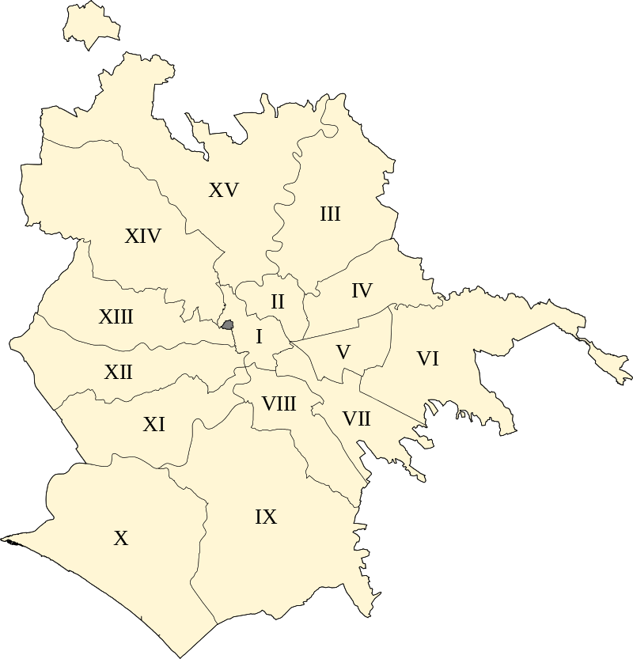
Aim of the Project
The aim is to examine the complaints to understand the issues, roles, and numbers with the aim to uncover any underlying data structure and to forecast future complaints in each Municipio.
In a nutshell, we want
to predict where the next complaints will be and what they will be about.

Slide 4
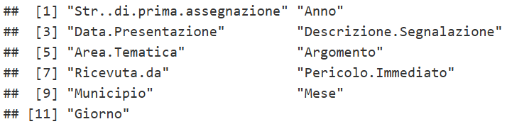
Dataset
 | Definition
Str..di.prima.assegnazione | The initial office or structure to which the report was assigned
Anno | The year the report was submitted
Data.Presentazione | The date the report was registered (year-month-day)
Descrizione.Segnalazione | The description of the type of report made (complaint, report…)
Area.Tematica | The thematic area to which the report belongs (security, waste management, public transportations…)
Argomento | The specific field
Ricevuta.da | The channel through which the report was received (e.g., Call Center, Email)
Pericolo.Immediato | Urgent or not (True/False)
Municipio | The municipality of Rome to which the report pertains
Mese | The month the report was registered (1-12)
Giorno | The day of the week the report was registered (0-6: Sunday - Saturday)
We collected all the needed information through the public dataset, covering on a daily basis the period running from 2021 up to the start of 2024.
Some months were entirely missing and data were presented in extremely different formats, hence an intensive pre-processing was needed.
At the end, the following was the structure of the dataset:

Slide 5
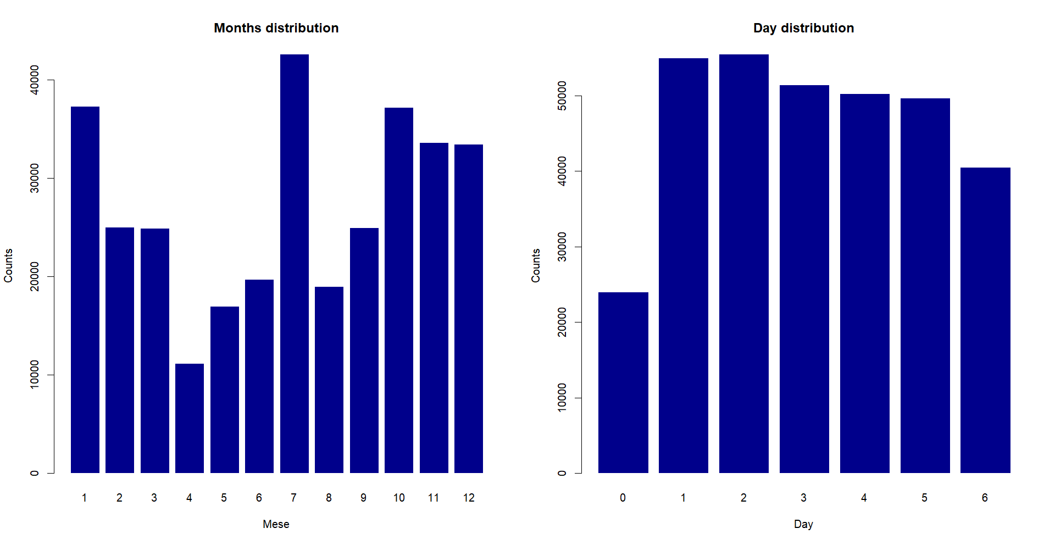
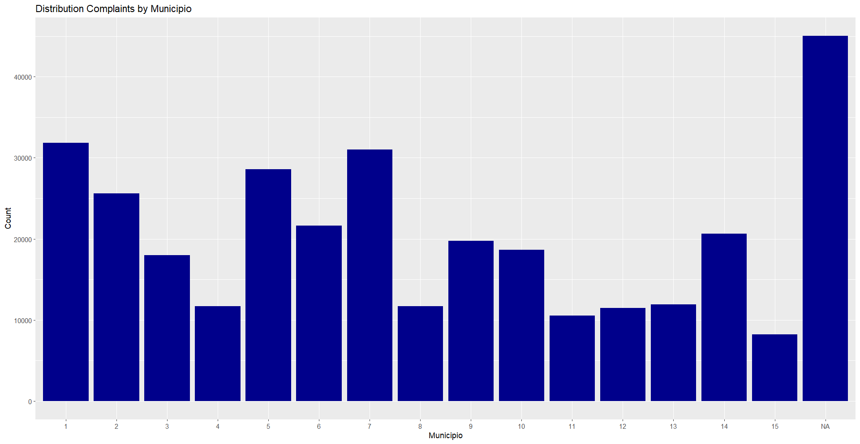
Exploratory Analysis - 1
We noticed a quite consistent monthly seasonality that we needed to work on. Even though there is an average drop on the amount of complaints in the weekend, further investigations suggested that there is no relevant weekly seasonality.
Municipio I is the one with the highest number of complaints, followed by VII, V and II.
We also have NA column, meaning the complaints that were not assessed to a specific Municipio, but the city as a whole.

Slide 6
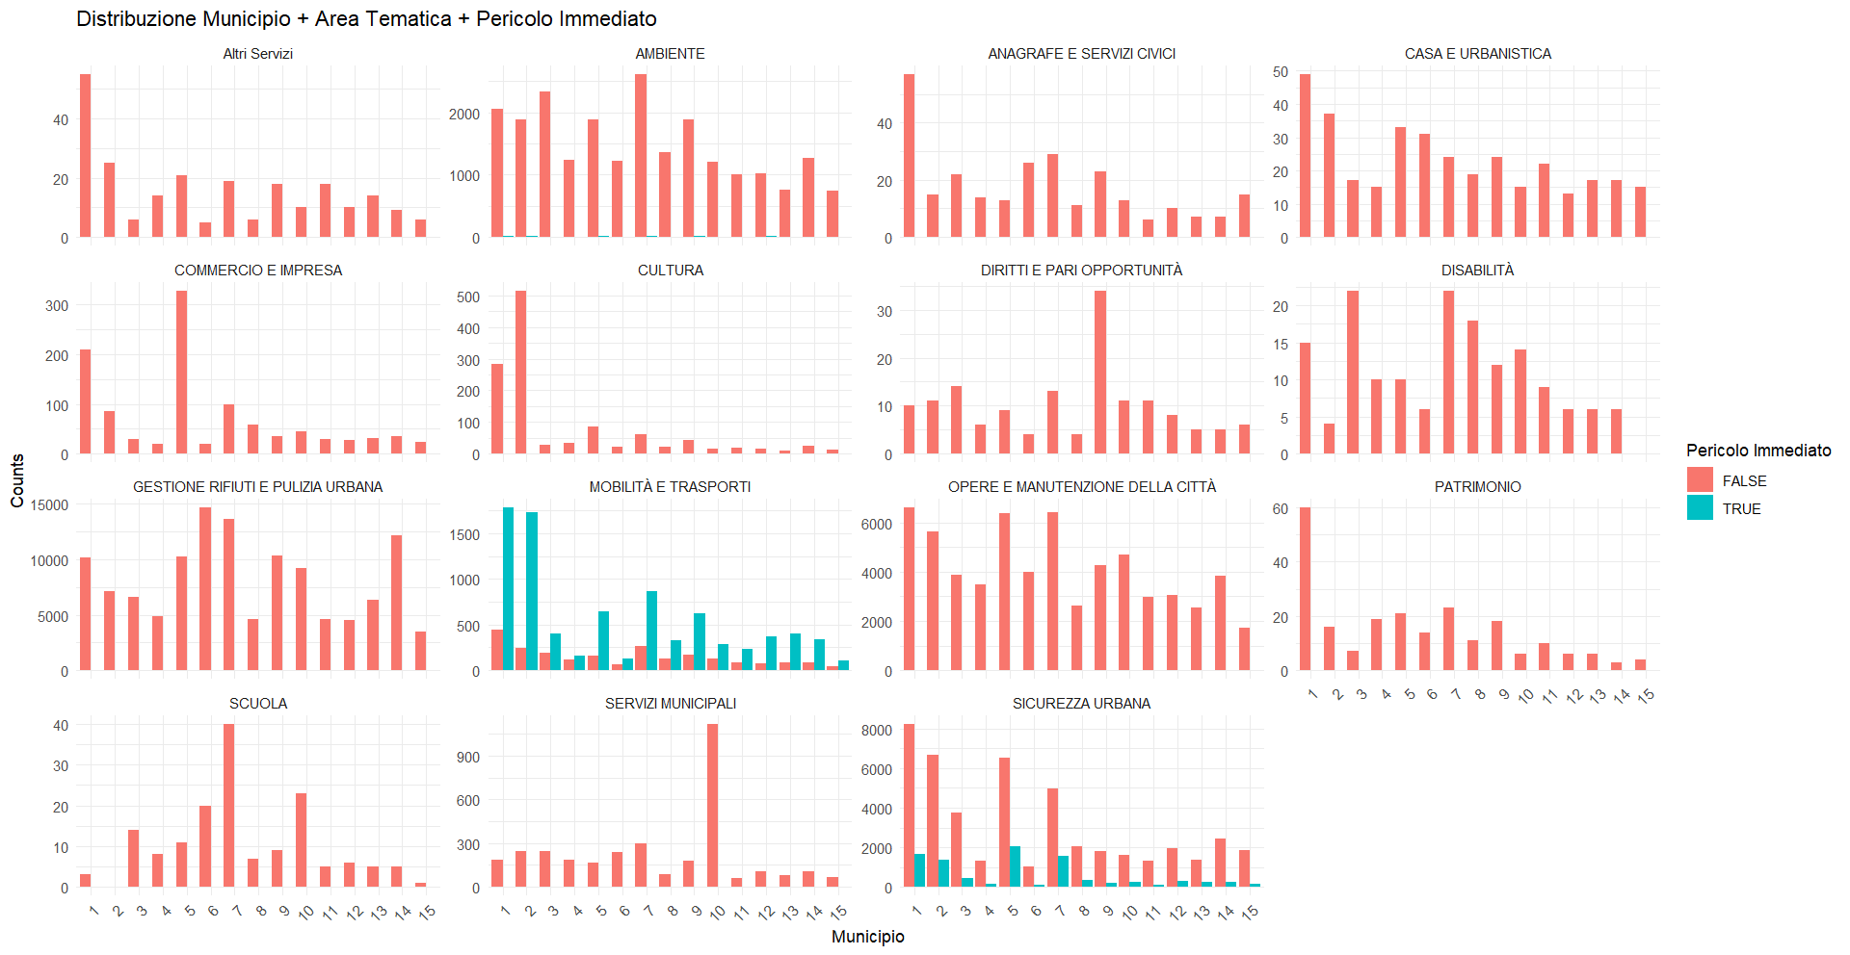
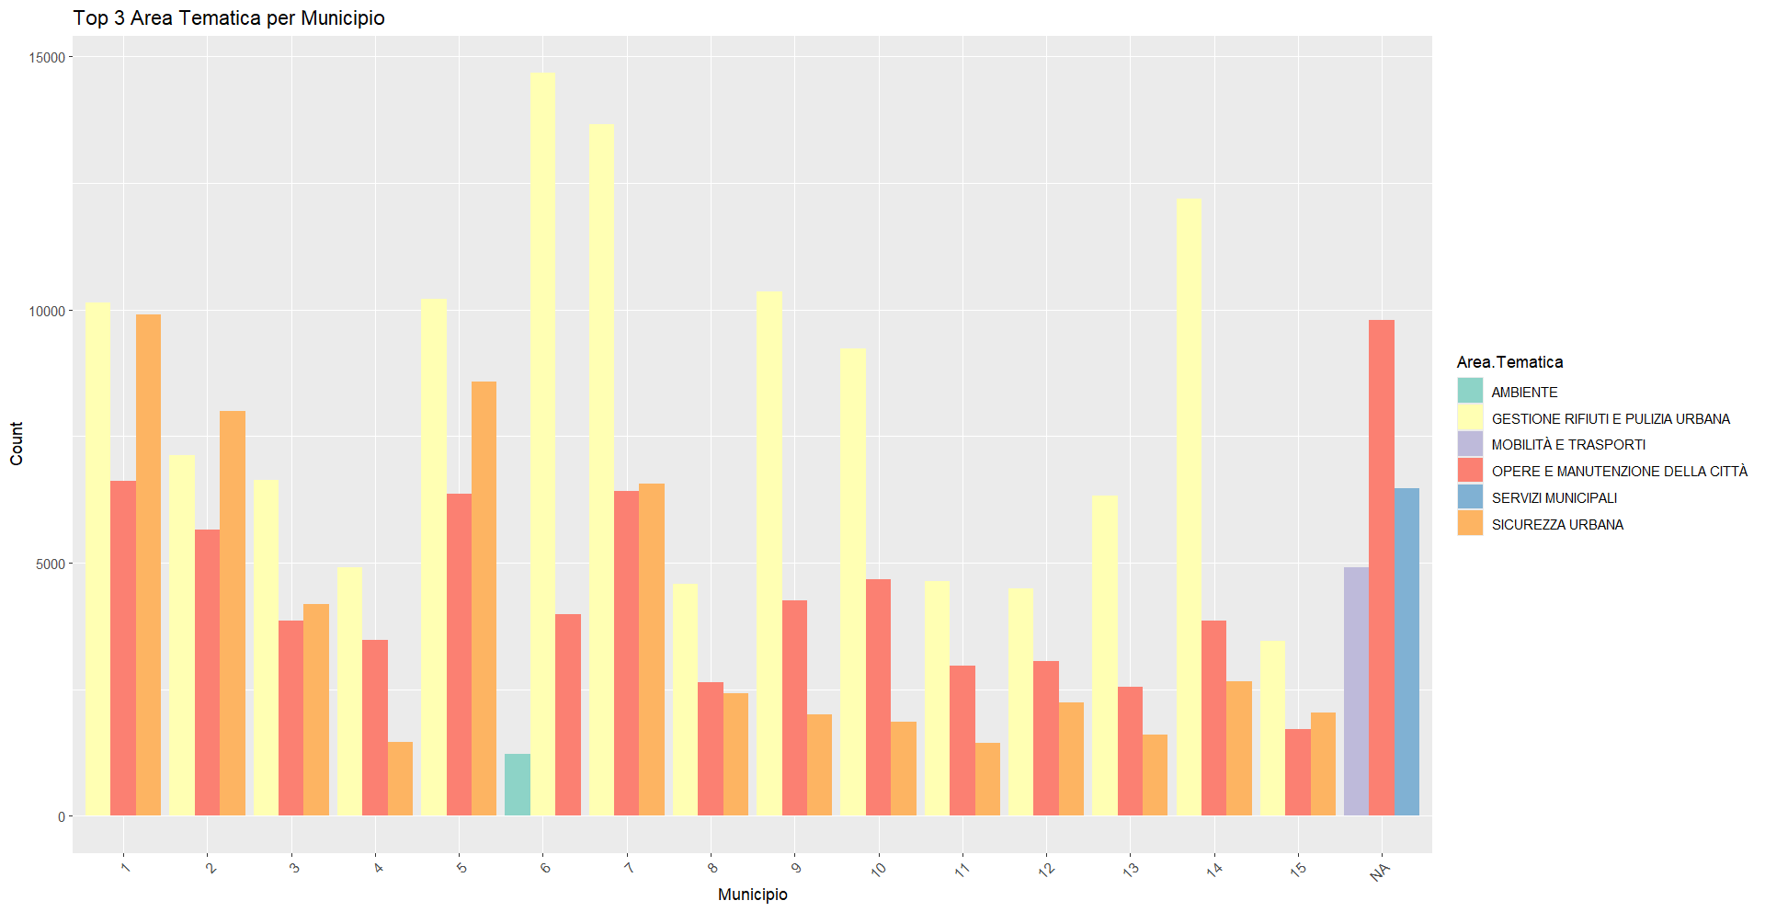
Exploratory Analysis - 2
The distribution of the amount of complaints in a specific thematic area is very municipally dependent.
We can see it for the most popular areas, that will also hold a key position in model-based analysis.

Slide 7
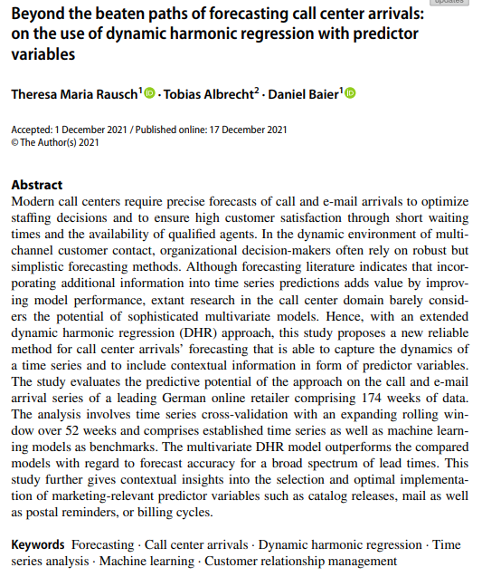
Methods
To reach our goal, several articles suggested the implementation of 2 kinds of models: Dynamic Harmonic Regression and Random Forest. Due to some discontinuity in the dataset, we decided to trim it leaving only the portion from July 2021 to March 2023. This allowed our models to deal with time series containing one observation per day.
DHR is often combined with ARIMA models to account for both seasonal and non-seasonal components
Random Forest for time series prediction is a machine learning method that uses an ensemble of decision trees
Random Forest
DHR
Uses Fourier terms to handle
seasonality.
The ensemble nature makes it robust to noise and outliers in the data
Suitable for time series with evolving trends.
Suitable for time series with intricate patterns.
Notes:
Random forest article hangisi?

Slide 8
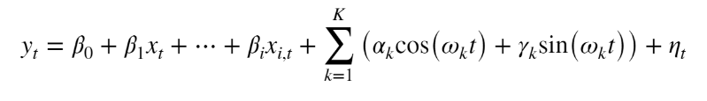
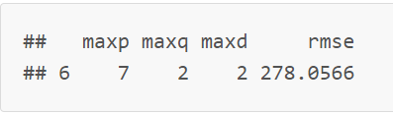
Dynamic Harmonic Regression
Dynamic Harmonic Regression is a model that adds up predictive variables, a Fourier sum and a non-seasonal ARIMA process. DHR is able to deal with seasonality, that in our case is only annual.
Modelling over the whole dataset, over single municipalities and over thematic areas into municipalities, in general the relevant regressors were whether a day was a festivity or not and the belonging of the complaints to their thematic area, with some slight differences between the specific cases.
Additionally, for parameter tuning we applied Time Series Cross Validation to test and observe RMSE for different maxp (the number of lagged observations included), maxq (the number of lagged forecast errors included), and maxd (the number of times the data needs to be differenced to achieve stationarity) values.
Notes:
(maybe a picture with the results of all coefficients for a specific model and residuals, I have to pick one, we can add it at the end)
Our implementation (code and maybe pseudo code)
Our selected parameters

Slide 9
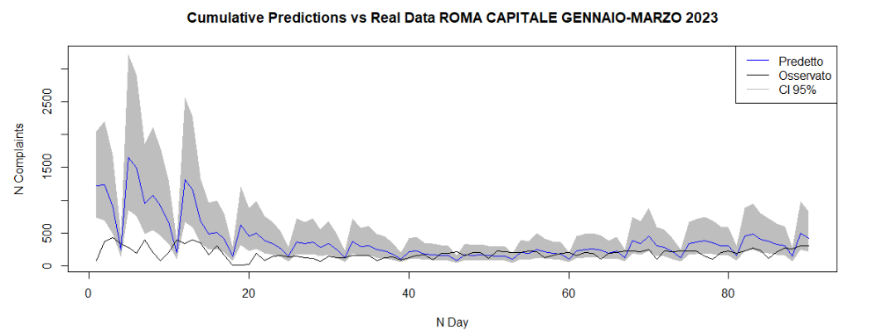
Dynamic Harmonic Regression – Predictions 1
Notes:
(only plots — with oral comment — about predictions, again I have to pick the most representative plots)
I put Municipio 1 but we can use the results for another municipio

Slide 10
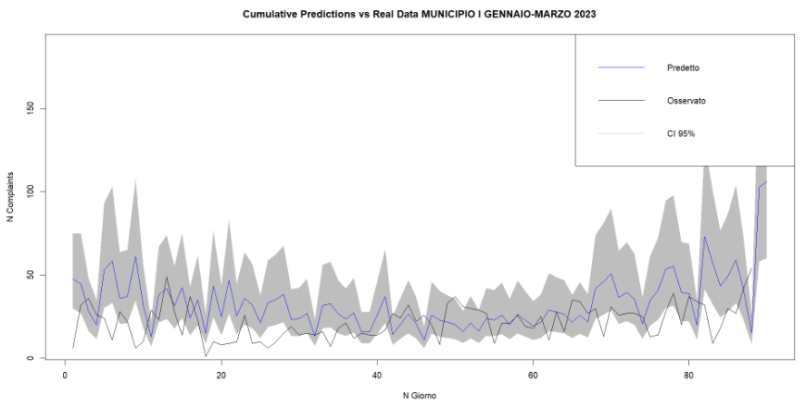
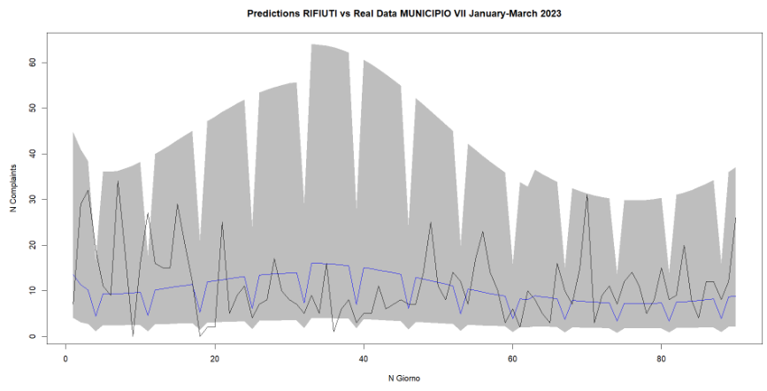
Dynamic Harmonic Regression – Predictions 2
Notes:
(only plots — with oral comment — about predictions, again I have to pick the most representative plots)
I put Municipio 1 but we can use the results for another municipio

Slide 11
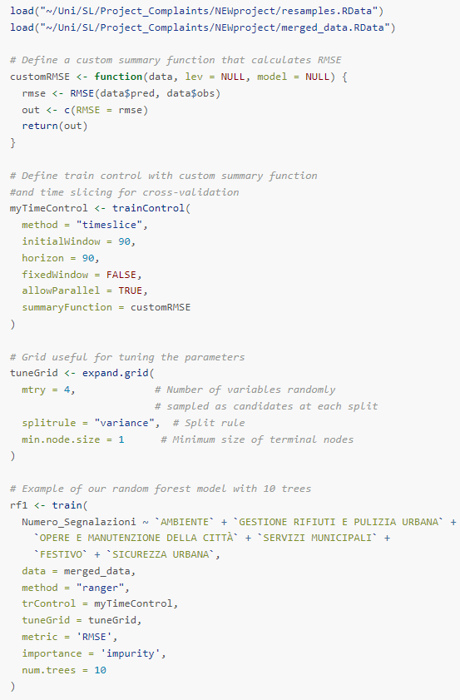
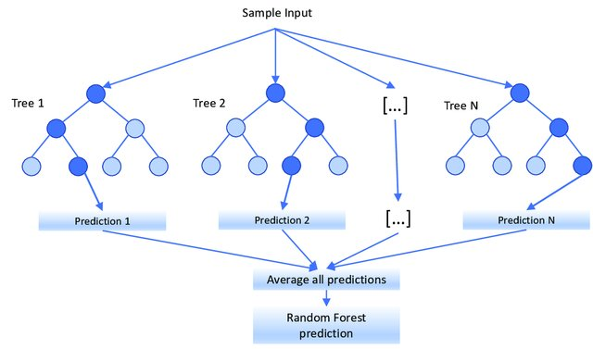
Random Forest
Random Forest is a popular ensemble machine learning algorithm that belongs to the supervised learning technique. It is an ensemble learning method that uses bagging constructing a multitude of decision trees at training time and outputting the mean/average prediction (regression) of the individual trees.
Notes:
Definition
Our implementation (code and maybe pseudo code)
Our selected parameters

Slide 12
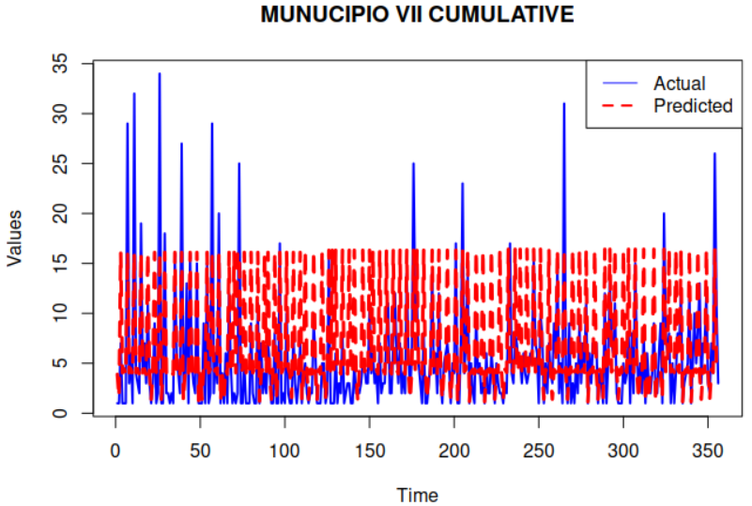
Random Forest – Predictions

Slide 13
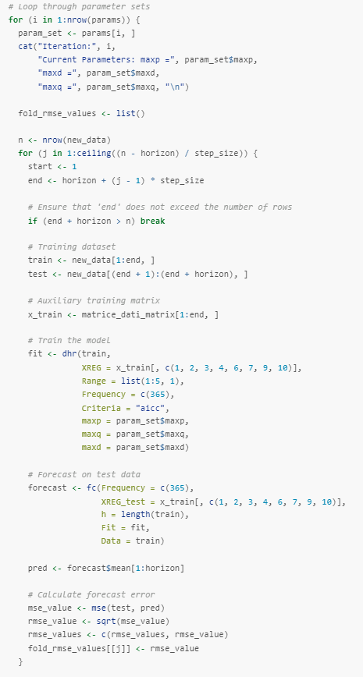
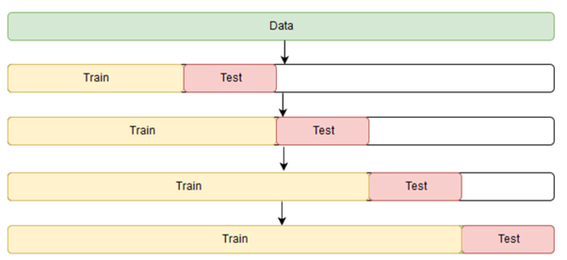
Model Comparision - 1
We used Time Series Cross Validation to both trying out parameters for both models and to compare the models with each other. The idea is to start with a small subset of data for training, forecast for the later data points and then check the accuracy. These data points are then included as part of the next training dataset and subsequent data points are forecasted.
Notes:
TSCV definition
Our implementation (step by step thing)
Results
Change the code

Slide 14
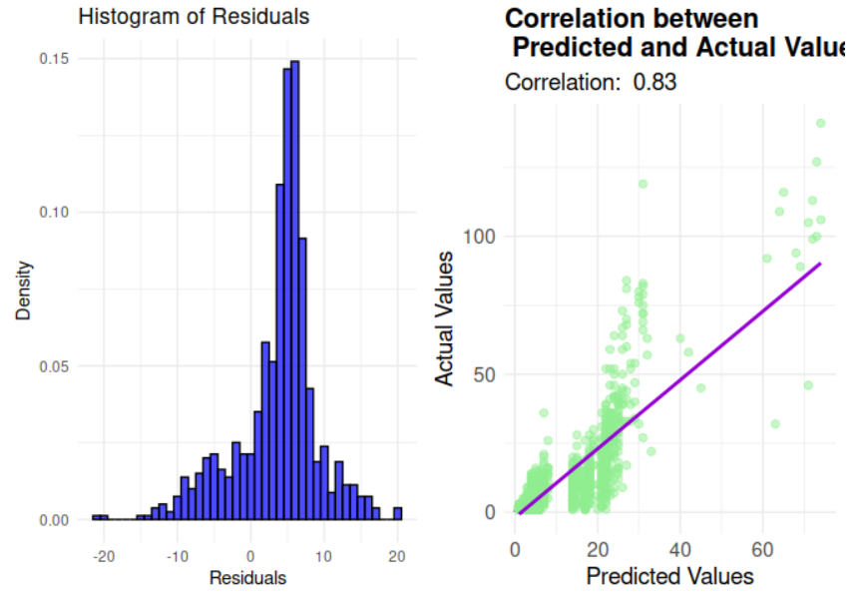
Random Forest – Residuals

Slide 15
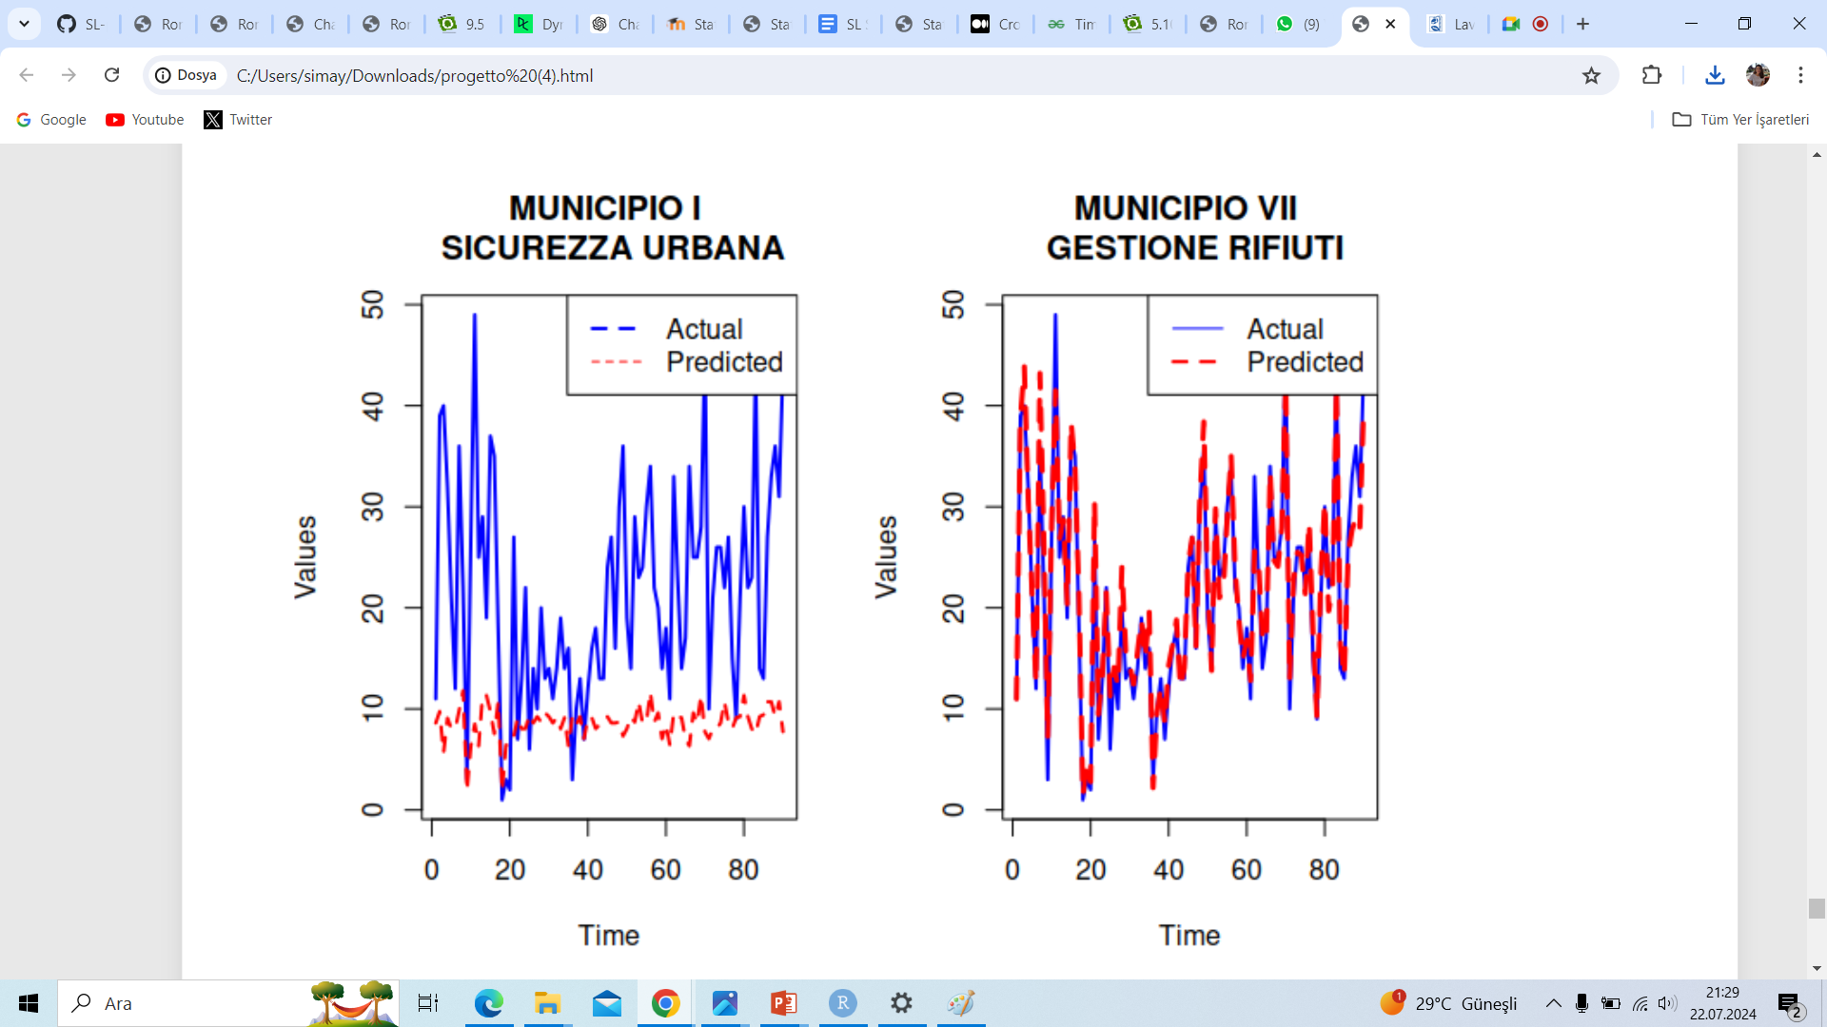
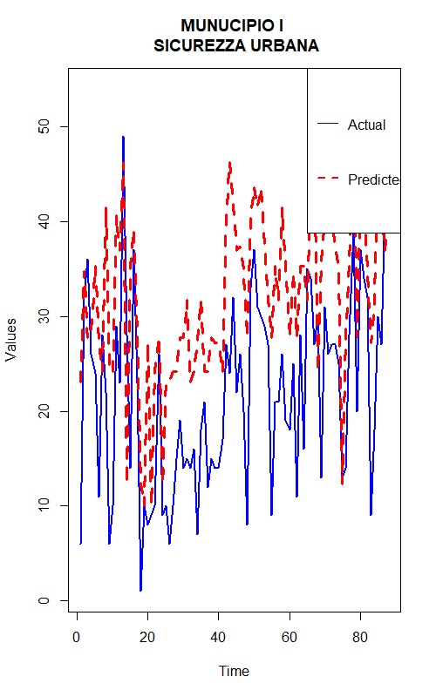
FINAL PREDICTIONS
Notes:
Last predictions
Last graphs
Final comments

Slide 16

Conclusions
DHR
RMSE (Cumulative): 278
RMSE (Municipio I): 26
RMSE (Municipio VII – GESTIONE RIFIUTI): 12
PROS: In general, better for seasonality
CONS: Tendency to overestimate, high sensitivity for outliers
RANDOM FOREST
RMSE (Cumulative): 8
RMSE (Municipio I): 16
RMSE (Municipio VII – GESTIONE RIFIUTI): 4
PROS: Ability to handle larger number of predictors effectively, robustness in dealing with complex data patterns
CONS: Higher computational time
Random Forest
Notes:
Last predictions
Last graphs
Final comments
We are working with one year of seasonality so for example maybe if we had more years of data DHR could perform better than it did here.
Even with one year seasonaliy, DHR has better results when it is focusing on one tematic area or on one municipio. For example Municipio I was the only one that didnt have overestimates in DHR model at the beginning, that’s why it performs better compared to the cumulative model although it is still worse than the one for the Random Forest.

Slide 17
THANK YOU ☺

